Slide 1
AI-POWERED HOURLY ATTENDANCE CAPTURING SYSTEM
PRESENTED BY:
UFAIRA TAZHEEN(18UK1A05B4)
BOLUKONDA YASHASWI(18UK1A05C6)
SUJAY CHELLA(18UK1A05B0)
AKULA LOKESH(18UK1A05C1)

Slide 2
CONTEXT
INTRODUCTION.
OBJECTIVE.
DATA COLLECTION.
PROJECT WORKFLOW.
REQUIREMENTS.
CONCLUSION.

Slide 3
INTRODUCTION
Maintaining attendance is very important in all the institutes for checking the attendance percentage of Students. Every institute has its own method in this regard. Some are taking attendance manually using the old paper for every hour and later they will upload every hour data of a class to the server or file-based approach and some have adopted methods of automatic attendance using some biometric techniques. But in these methods students have to wait for a long time in making a queue for every hour. In the Process of making attendance every hour, the students may lose some portion of class every day. So this project focuses on creating an automated system that takes the attendance of students on hourly bases using preinstalled cameras in the classes. We make use of AWS services to marks the attendance, store the attendance in DB .

Slide 4
OBJECTIVE
By the end of this project
You’ll be able to work with AWS Rekognition, DynamoDB, lambda functions and API Gateway.
Hands-on experience on Opencv.
Know how to create a table in AWS Database
Work with Http Requests
Create Rest APIS
Work with Flask
Integrate Web App with AWS services

Slide 5

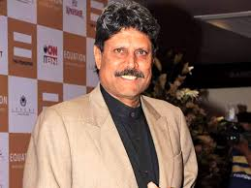
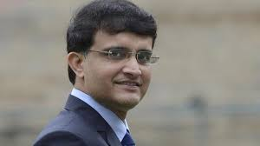
DATA COLLECTION
As we are building a face recognition based smart attendance system, we should acquire the images of students to train the machine.
So collect the images of all the students - one image for a student is suffice.
For this project, we have collected the images of Sehwag, Ganguly , and Kapil dev.

Slide 6
PROJECT OVERFLOW
Store the Images of Students in S3 Bucket.
create collectionID name for student's faces.
create individual collectionIDs.
Capture the image on Hourly basis.
Load the image to Face comparison algorithm (compares the faces in s3 bucket).
Mark the attendance for compared faces and store in DynamoDb.
Create a rest API using API gateway and lambda function to connect to dynamo DB through web app.
Create a web-based dashboard to visualize the attendance.

Slide 7
REQUIREMENTS
ANACONDA NAVIGATOR.
AWS SERVICES:
IAM USER
S3 BUCKET
DYNAMO DB
API GATEWAY
LAMBDA FUNCTION

Slide 8
CONCLUSION
We are automating the attendance system to decrease the errors that occur due to the manual taking attendance. If the cameras monitoring into classrooms to evaluate their interest and to mark attendance, students tends to pay attention if Artificial Intelligence enabled method can monitor and mark their attendance and faculties will at least come to school or college every day because, in early times they are coming and putting sign and they are letting the school or college now it’s not possible if the faculty left the college the system automatically marks as absent so everyone will come to school or organization regularly. Using the artificial intelligence concept the attendance monitoring system is very secure, accurate and easy to monitor students and faculty’s attendance.

Slide 9


